Slide 1
Artificial Interaction in the World
By: Marian Siri

Slide 2
What is Artificial Intelligence?
Artificial Intelligence is a theory and development of computer systems that are able to perform tasks that normally require human intelligence
Examples: speech recognition, face recognition, decision- making, and translation between languages

Slide 3
How Does AI Work?
It can learn what it has to do once and repeat it, as many times as desired by its human programmer. AI makes it possible for machines to adjust to new inputs and perform human-like tasks .
Artificial Intelligence takes over repetitive or dangerous tasks.
It frees up humans’ time, allowing them to perform tasks that involve creativity.

Slide 4
How is it a Part of Our Daily Lives?
Travel Navigation
Smartphones
Smart Cars
Drones
Smart Home Devices
GPS
Uber and Lyft
Apple
Samsung
AI Chips that can perform up to 5 trillion operations per second
Face ID
Tesla electric Cars
Self drive
Self park
Drone delivery programs
Alexa
Google Home
Security Systems

Slide 5
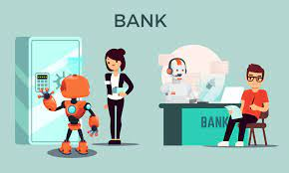
AI in the Finance Industry
Artificial intelligence can be used to analyze data to find the best place to invest money.
The finance industry relies on Artificial Intelligence, in customer service and fraud protection.
Example
Automated email that a person receives from the bank when there is a strange transaction.

Slide 6
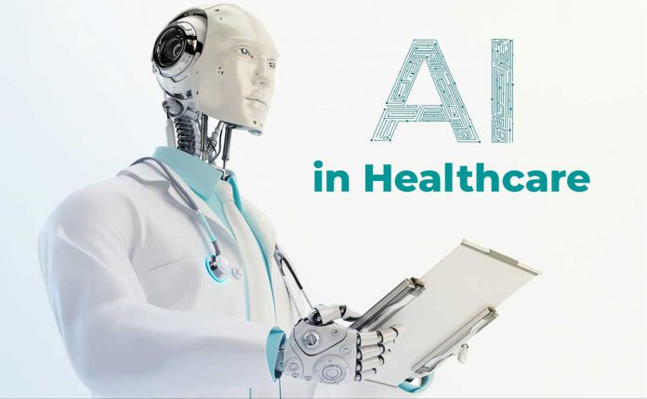
AI in the Health Industry
AI in the health industry has several benefits.
- They can automate tasks and analyze patients’ data to deliver better healthcare at a lower cost.
Examples
Robot surgeons (A surgeon is a spectator )
AI can aid in preventative medicine and new drug discovery
Google cloud’s Healthcare app makes it easier for health organizations to collect, store, and access data
Fitbits and smartwatches analyzed data to alert users on health issues

Slide 7
How is AI Affecting Human Interaction
AI is used for human interaction.
- Social media
- Chat bots
- Call Attendants
Many social and psychological problems are being caused by the decline in human interaction and the rise of robotic communications.
- Talking to robots increases anxiety and depression
- Can encourage anger and frustration
The machine age is making people more restless, and more irritable.
People are losing input and do not learn how certain things work. They are giving up independence and privacy over choice. This effect will grow as AI become more prevalent and complex.
If humans continue to depend on AI it will erode their abilities to
- interact effectively with others
- think for themselves

Slide 8
Negative Effects
Invasion of privacy
Most AI tools are and will be in the hands of companies striving for profits or governments striving for power
AI terrorism
Autonomous military applications
cybercriminals' reach into economic systems.
Loss of Human jobs
The efficiencies of code-based machine intelligence will continue to disrupt all aspects of human work.
Agriculture jobs
Security jobs

Slide 9
Conclusion
AI is continuing to expand and grow everyday allowing humans to have an easier and simpler life.
It is a part of our daily personal and professional online lives.

Slide 10
References
https://www.meer.com/en/64215-artificial-intelligence-has-changed-our-world
https://www.weforum.org/topics/artificial-intelligence-and-robotics
https://www.forbes.com/sites/cognitiveworld/2019/02/24/ai-transforming-the-world/?sh=34b0dc234f03
https://www.pewresearch.org/internet/2018/12/10/artificial-intelligence-and-the-future-of-humans/
https://journalofbigdata.springeropen.com/articles/10.1186/s40537-019-0202-7
https://www.insiderintelligence.com/insights/artificial-intelligence-healthcare/
https://www.linkedin.com/pulse/how-ai-ml-interactions-affecting-humans-daniel-abbott?trk=pulse-article_more-articles_related-content-card

